Slide 1

Streams in node.js

Slide 2

Reading Files Without Streams
When reading a file traditionally in Node.js using fs.readFile(), the entire file is loaded into memory before any processing can begin. This can lead to high memory consumption, especially for large files, and may cause performance issues or even crashes if memory runs out. This approach is inefficient for handling large data sets or when dealing with multiple concurrent requests.

Slide 3
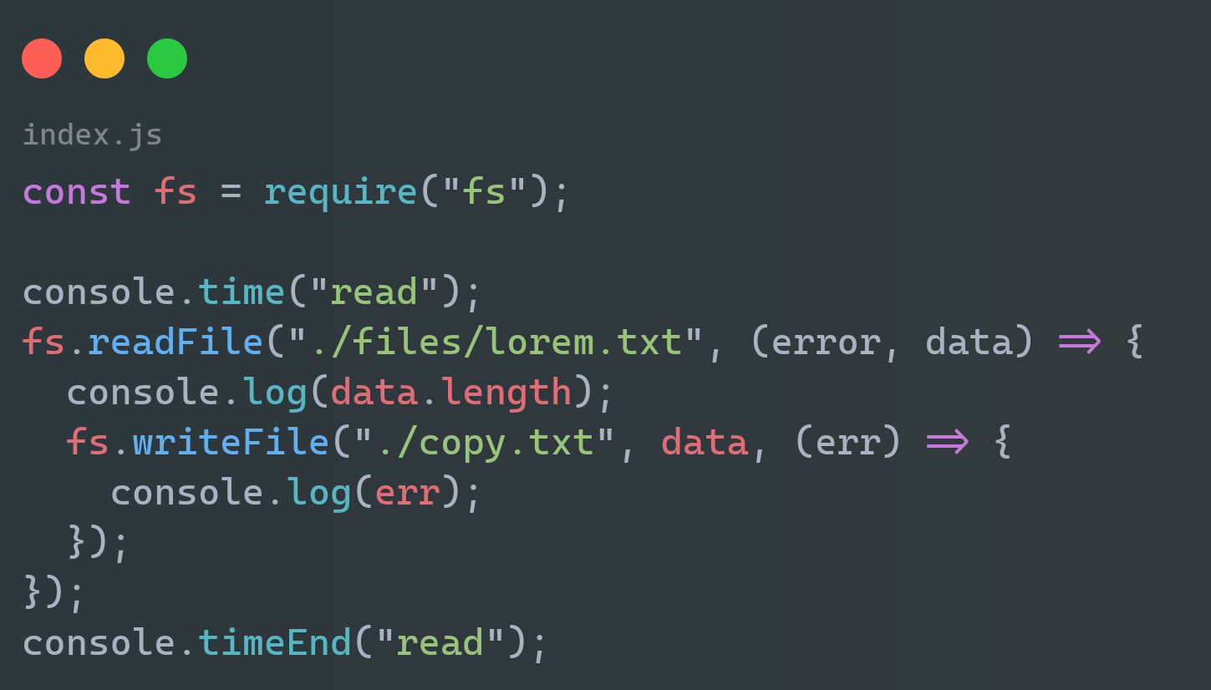
Example :

Slide 4
Example :

Slide 5

oops

Slide 6
What are Streams?
Streams are a method in Node.js used to process large amounts of data efficiently. Instead of loading an entire dataset into memory at once, streams allow you to handle data in smaller, manageable chunks as it is being transmitted. This reduces memory usage and speeds up data processing, making streams ideal for working with tasks like file handling, reading and writing data over networks, and working with large datasets.

Slide 7
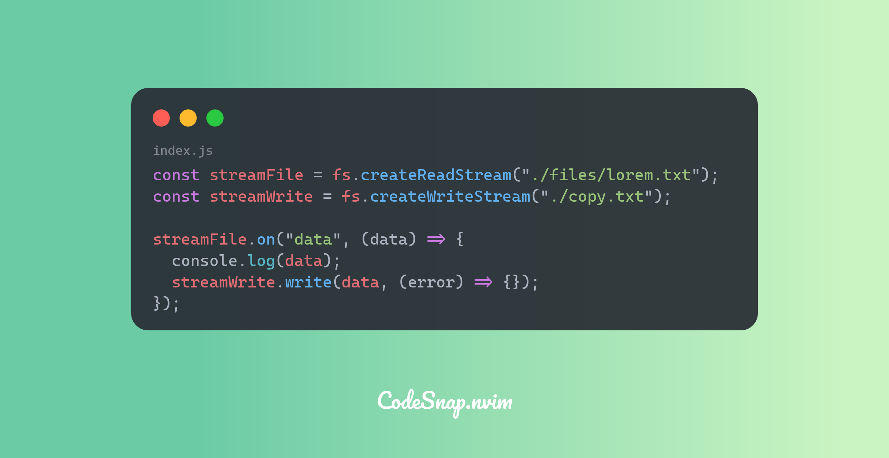
Example :

Slide 8


Slide 9


Happy memory :
Sad memory :

Slide 10
What is a Chunk?
Chunk is a small, manageable piece of data that is processed individually as it is being read or written.
What is a buffer?
Buffer is a temporary storage area in memory that holds data while it is being moved from one place to another.

Slide 11
Thanks

